Slide 1
Undergraduate Policy Major
Princeton School of Public and International Affairs
with Zacharia Ahmed

Slide 2
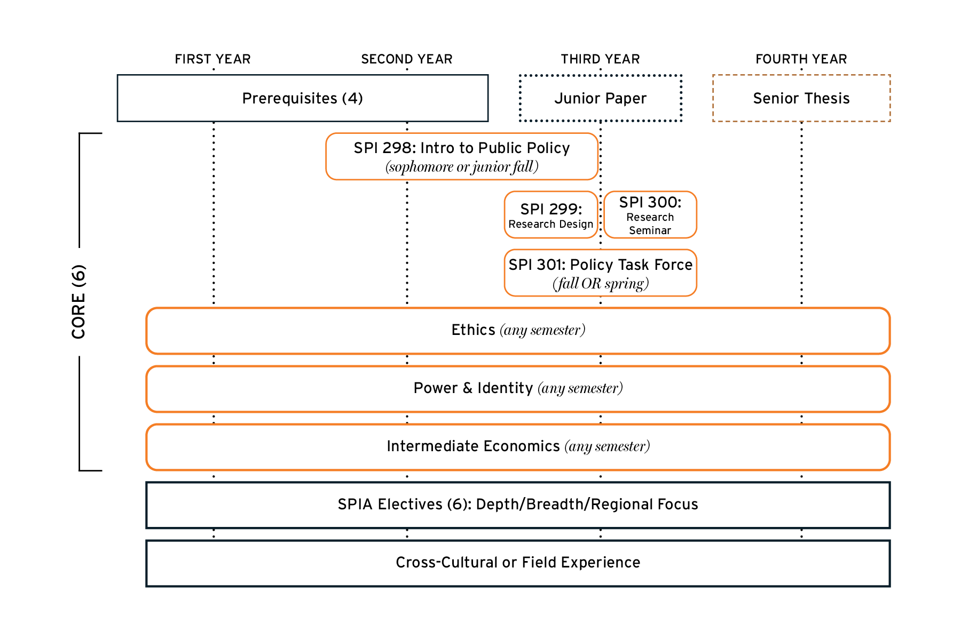
FOUR YEAR RHYTHM

Slide 3
Core Courses (6)
SPI 298
Intro to Public Policy (FALL ONLY)
SPI 299
Research Design (FALL ONLY) Currently non-credit bearing
SPI 300
Research Seminar (SPRING ONLY)
SPI 301
Policy Task Force (FALL or SPRING)
Intermediate Economics
Power & Identity (CD)
Ethics (EM)
School of Public and International Affairs
Undergraduate Major
Course Requirements (16)
Pre-requisites (4)
Statistics (fulfills QCR distribution requirement)
Microecon
History/ Politics (HA or SA)
Sociology / Psychology (SA or EC)
ECO 100
Junior Independent Work
SPI 200
ECO 202
ORF 245
POL 345/SPI 211
SML 201
Senior Independent Work
See website for
detailed list
Electives (6)
Disciplinary Breadth AND Intellectual Depth
SPI 304
ECO 300
ECO 301
ECO 310
ECO 311
See website for
detailed list
Regional Focus
(across prerequisites, core, and electives)
See website for
detailed list
SPI 365
SPI 370
POL 307
POL 313
CHV 310/PHI 385
PHI 309/CHV 309
Cultural/Field-Work

Slide 4
SPI 300: Research Seminar
SPI 301: Policy Task Force
Prerequisite: SPI 299 Introduction to Research Design
SPI 299 and 300 will complete your junior independent work requirement and your JP will be completed within SPI 300.
Although SPI 299 is P/D/F on the transcript, the instructor will assign an A-F grade which will count for 30% of your JP grade.
SPI 300 is primarily taken in the Spring of your Junior Year, unless you are planning to study abroad during that time.
A Google form will be sent out in the fall of your Junior year to rank the Research Seminar topics available.
Research Seminar assignments will be announced before Spring course registration.
Prerequisite: SPI 298 Introduction to Public Policy
If SPI 298 is taken in the Fall of your Junior Year, you will need to wait to complete SPI 301 in the following Spring Semester.
The Policy Task Force is a unique, experiential course where you learn about the policy-making process in real-time with partner organizations.
A Google form will be sent out after declaration to rank the Policy Task Force topics available.
Policy Task Force assignments will be announced before Spring course registration.
Notes:
This course is credit bearing and not tied to the JIW

Slide 5
Policy Advocacy Clinic
First-of-its-kind program that immerses students in the policymaking process through both in-class instruction and hands-on engagement
Learn how to (1) devise public policy solutions to social problems; (2) move an issue through the policy cycle; and (3) engage in advocacy to advance public policy
One-year, two-semester commitment – working locally, nationally, and internationally
Information Session: Wednesday, March 26 @ 12:30pm in Robertson Hall, 023
Application Deadline: April 15
Notes:
This course is credit bearing and not tied to the JIW

Slide 6
Considerations for Study Abroad
Options to study abroad in SPIA:
Junior Fall – location of your choice
Junior Spring – location(s) determined by SPIA
Senior Fall – location of your choice, but you must have a confirmed thesis advisor by the end of junior spring
If you plan to study abroad in the spring of your Junior year, you must:
Complete SPI 299 AND SPI 300 in the Fall of your Junior Year.
Complete your JP during the Fall of your Junior Year
Failure to complete SPI 299 and SPI 300 in Fall of your Junior Year will make you ineligible to study abroad in the Spring of your Junior Year.
Notes:
This course is credit bearing and not tied to the JR Independent Work
Reminder: OIP will be presenting after me

Slide 7
ELECTIVES
(6 courses)
Intellectual Depth (3)
AND
Disciplinary Breadth (3)
Please note: all electives must be approved and listed on the master course list to count.
Additionally, all courses are recorded based on the home department title, no cross-listed departments will be taken into account

Slide 8
ELECTIVES
(6 courses)
Intellectual Depth (3)
Thematic Depth: Three courses bound by a theme, drawn from SPIA-affiliated departments or SPIA-approved courses. Thematic areas include:
Community and Individual Health, Education
Economic Development
Environment & Energy
Globalization & International Relations
Governance, Law & Citizenship
Inequality & Human Rights
National and International Security & Conflict
Disciplinary Depth: Three courses in one SPIA-affiliated department – e.g., CEE, COS, ECO, EEB, GEO, HIS, MAE, POL, PSY, SOC, SPI
OR
Notes:
Google form needed for Thematic depth – default Disciplinary Depth
Make sure that the course(s) you are looking at are approved on our electives list.

Slide 9
ELECTIVES
(6 courses)
Disciplinary Breadth (3)
One course from each of three SPIA-related departments (CEE, COS, EEB, GEO, HIS, MAE, POL, PSY, SOC, SPI) not already covered by intellectual depth.
The SPIA-related department used to fulfill the Breadth should not overlap with you Depth electives (with exception to one course for the Theme)
ECO excluded as it’s already a required prerequisite and Core course.
Prerequisites and core courses may double count for the disciplinary breadth electives; ECO courses may not.

Slide 10
Master Course List
Notes:
This course is credit bearing and not tied to the JIW

Slide 11
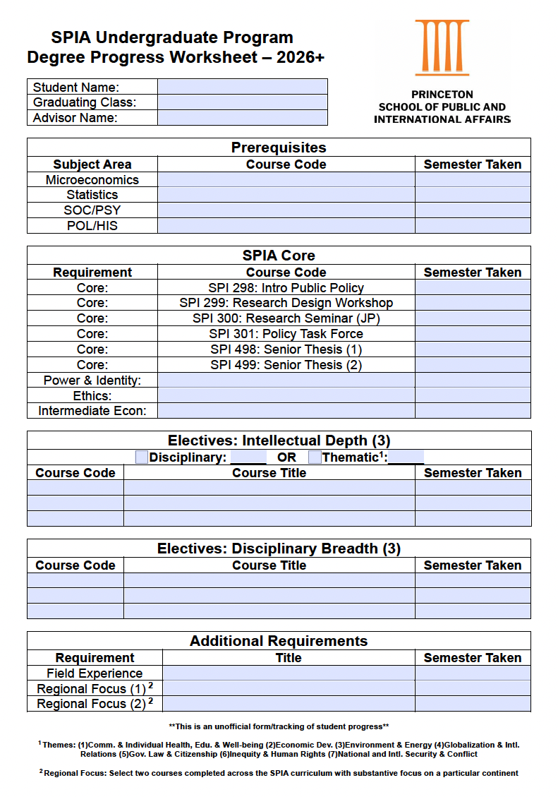
Tracking Progress
Fillable PDF found on the SPIA website
Use in collaboration with your advisor to ensure you are on track with all SPIA course work
Strongly encourage all students to start using this now!
Notes:
This course is credit bearing and not tied to the JIW

Slide 12
Things to keep in mind…..
Regional Focus Across the SPIA prerequisites, core, and electives,
at least two courses must have a substantive
focus on one particular continent.
AB general requirements will not be taken into consideration for this.
Notes No course may count as two (2) prerequisites, or core, or elective courses.
A single course may double or triple count as a prerequisite, core, and/or elective.
Among the six (6) electives, only three (3) courses may come from a single department.
Across entire concentration, a maximum of five (5) courses may come from a single department, not including SPI courses.
Notes:
Curriculum linked to electives title

Slide 13
SPIA CULTURAL /
FIELD-WORK REQUIREMENT
Examples from past years…
Study Abroad
Internships - Gov't
Internship - Non-Profit
Internship - PICS
Internship - Int'l Agency
Service in Underdeveloped Communities
Princeton Bridge Year
Global Seminars
Thesis Research
ROTC
Note: It is strongly recommended to check with our office to ensure that your experience will fulfill this requirement.

Slide 14
Princeton School of Public and International Affairs
UNDERGRADUATE PROGRAM OFFICE
Zacharia Ahmed
Undergraduate Academic Advisor
Jennifer Skillman
Academic Coordinator
Georgette Harrison
Administrative Coordinator
Liz Choe
Director, Undergraduate Program & Career Services

Slide 15
Princeton School of Public and International Affairs
Questions?
Email: spiaugrd@Princeton.edu
Website: spia.princeton.edu

Slide 16
Important Dates
March 26 @ 12:30pm (RH 023): Policy Advocacy Clinic Info session
April 14: Deadline to declare
April 15: Policy Advocacy Clinic application due
April 17: Sophomore course registration for Fall 2025
April 23 @ 12:30pm (RH 023): Study Abroad info session
April 23 @ 4:30pm (Shultz Cafe): Declaration Celebration

