Slide 1



Undergraduate Policy Major
Princeton School of Public and International Affairs
with Zacharia Ahmed

Slide 2
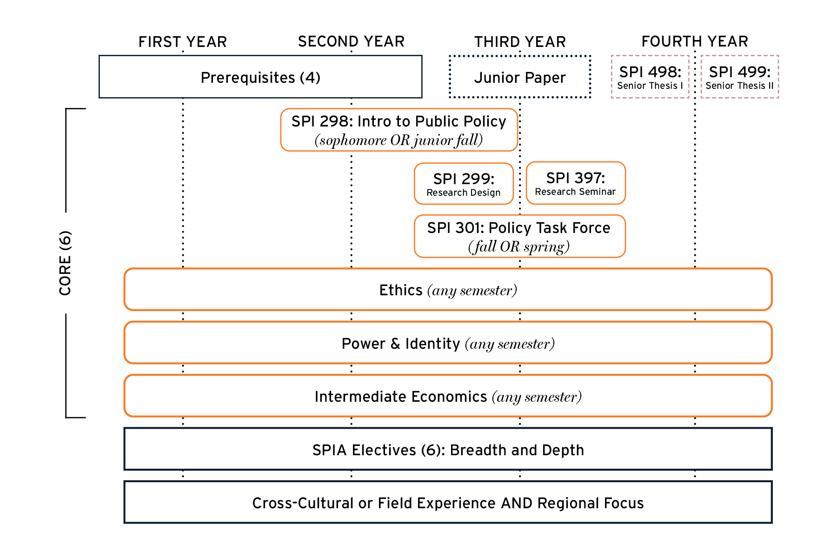
FOUR YEAR RHYTHM

Slide 3
Core Courses (9)
SPI 298
Intro to Public Policy (FALL ONLY)
SPI 299
Research Design (FALL ONLY)
SPI 397
Research Seminar (SPRING ONLY)
SPI 301
Policy Task Force (FALL or SPRING)
Intermediate Economics
Power & Identity (CD)
Ethics (EM)
School of Public and International Affairs
Undergraduate Major
Course Requirements
Pre-requisites (4)
Statistics (fulfills QCR distribution requirement)
Microecon
History/ Politics (HA or SA)
Sociology / Psychology (SA or EC)
ECO 100
Junior Independent Work
SPI 200
ECO 202
ORF 245
POL 345/SPI 211
SML 201
Senior Independent Work
SPI 498 & SPI 499
Electives (6)
Disciplinary Breadth AND Intellectual Depth
See website for
detailed list
SPI 304
ECO 300
ECO 301
ECO 310
ECO 311
See website for
detailed list
Regional Focus
(across all courses taken at Princeton)
See website for
detailed list
Cultural/Field-Work
See website for
detailed list

Slide 4
ELECTIVES
(6 courses)
Intellectual Depth (3)
AND
Disciplinary Breadth (3)
Please note: all electives must be approved and listed on the master course list to count.
Additionally, all courses are recorded based on the home department title, no cross-listed departments will be taken into account

Slide 5
ELECTIVES
(6 courses)
Intellectual Depth (3)
Thematic Depth: Three courses bound by a theme, drawn from SPIA-affiliated departments or SPIA-approved courses. Thematic areas include:
Community and Individual Health, Education
Economic Development
Environment & Energy
Globalization & International Relations
Governance, Law & Citizenship
Inequality & Human Rights
National and International Security & Conflict
Disciplinary Depth: Three courses in one SPIA-affiliated department – e.g., CEE, COS, ECO, EEB, GEO, HIS, MAE, POL, PSY, SOC, SPI
OR
Notes:
Google form needed for Thematic depth – default Disciplinary Depth
Make sure that the course(s) you are looking at are approved on our electives list.

Slide 6
ELECTIVES
(6 courses)
Disciplinary Breadth (3)
Three courses each from a unique SPIA-affiliated department listed here: CEE, COS, EEB, ENV, GEO, GHP, HIS, MAE, POL, PSY, SOC, SPI
The SPIA-affiliated department used to fulfill the Breadth should not overlap with you Depth electives
Among the six (6) electives, no more than three (3) courses may come from a single department.
ECO excluded as it’s already a required prerequisite and Core course.

Slide 7
Things to keep in mind…..
Regional Focus Across all course work
at least two courses must have a substantive
focus on one particular continent.
Notes
No course may count as two (2) prerequisites, or core, or elective courses.
A single course may double or triple count as a prerequisite, core, and/or elective.
Across entire concentration, a maximum of five (5) courses may come from a single department, not including SPI courses.
Notes:
Curriculum linked to electives title

Slide 8
Master Course List
Notes:
This course is credit bearing and not tied to the JIW

Slide 9
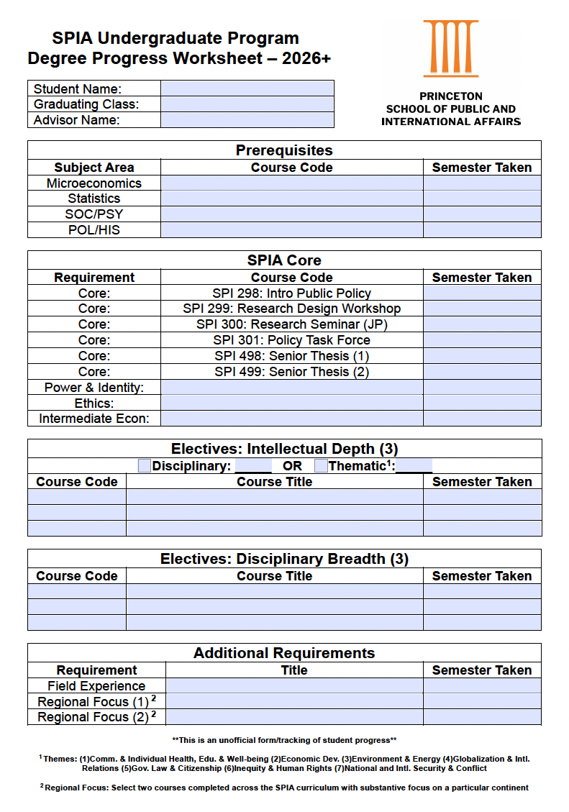
Tracking Progress
Fillable PDF found on the SPIA website
Use in collaboration with your adviser to ensure you are on track with all SPIA course work
Strongly encourage all students to start using this now!
Notes:
This course is credit bearing and not tied to the JIW

Slide 10
SPIA CULTURAL /
FIELD-WORK REQUIREMENT
Examples from past years…
Study Abroad
Internships - Gov't
Internship - Non-Profit
Internship - PICS
Internship - Int'l Agency
Service in Underdeveloped Communities
Princeton Bridge Year
Global Seminars
Thesis Research
ROTC
Note: It is strongly recommended to check with our office to ensure that your experience will fulfill this requirement.

Slide 11
Considerations for Study Abroad
If you plan on studying abroad in the fall of your Junior year, you must complete a research methods course in the spring of your Junior year, this will be in place of SPI 299.
If you plan to study abroad in the spring of your Junior year, you must complete SPI 299 AND SPI 397 in the Fall of your Junior Year.
Failure to complete SPI 299 and SPI 397 in Fall of your Junior Year will make you ineligible to study abroad in the Spring of your Junior Year.
Options to study abroad in SPIA:
Junior Fall – location of your choice
Junior Spring – University of Cape Town (UCT)
Senior Fall – location of your choice, but you must have a confirmed thesis adviser by the end of junior spring
Notes:
Sophomore Summer abroad?
This course is credit bearing and not tied to the JR Independent Work
Reminder: OIP will be presenting after me

Slide 12
Study Abroad Breakdown
 | Fall | Spring
SPI 299 |  | SPI 299 Equivalent
SPI 301
SPI 397
Study Abroad in the Fall:
 | Fall | Spring
SPI 299
SPI 301
SPI 397
Study Abroad in the Spring:
Notes:
Sophomore Summer abroad?
This course is credit bearing and not tied to the JR Independent Work
Reminder: OIP will be presenting after me

Slide 13
Important Dates
Declaration Period:
March 26 – April 14
Drop-in Advising Hours:
March 30 – April 17 @ 4:30 – 5pm
Declaration Celebration
April 22 @ 4:30pm
Notes:
Curriculum linked to electives title

Slide 14

Princeton School of Public and International Affairs
UNDERGRADUATE PROGRAM OFFICE
Zacharia Ahmed
Undergraduate Academic Adviser
Jennifer Skillman
Academic Coordinator
Georgette Harrison
Administrative Coordinator
Liz Choe
Director, Undergraduate Program & Career Services

Slide 15
Princeton School of Public and International Affairs
Questions?
Email: spiaugrd@Princeton.edu
Website: spia.princeton.edu

Slide 16
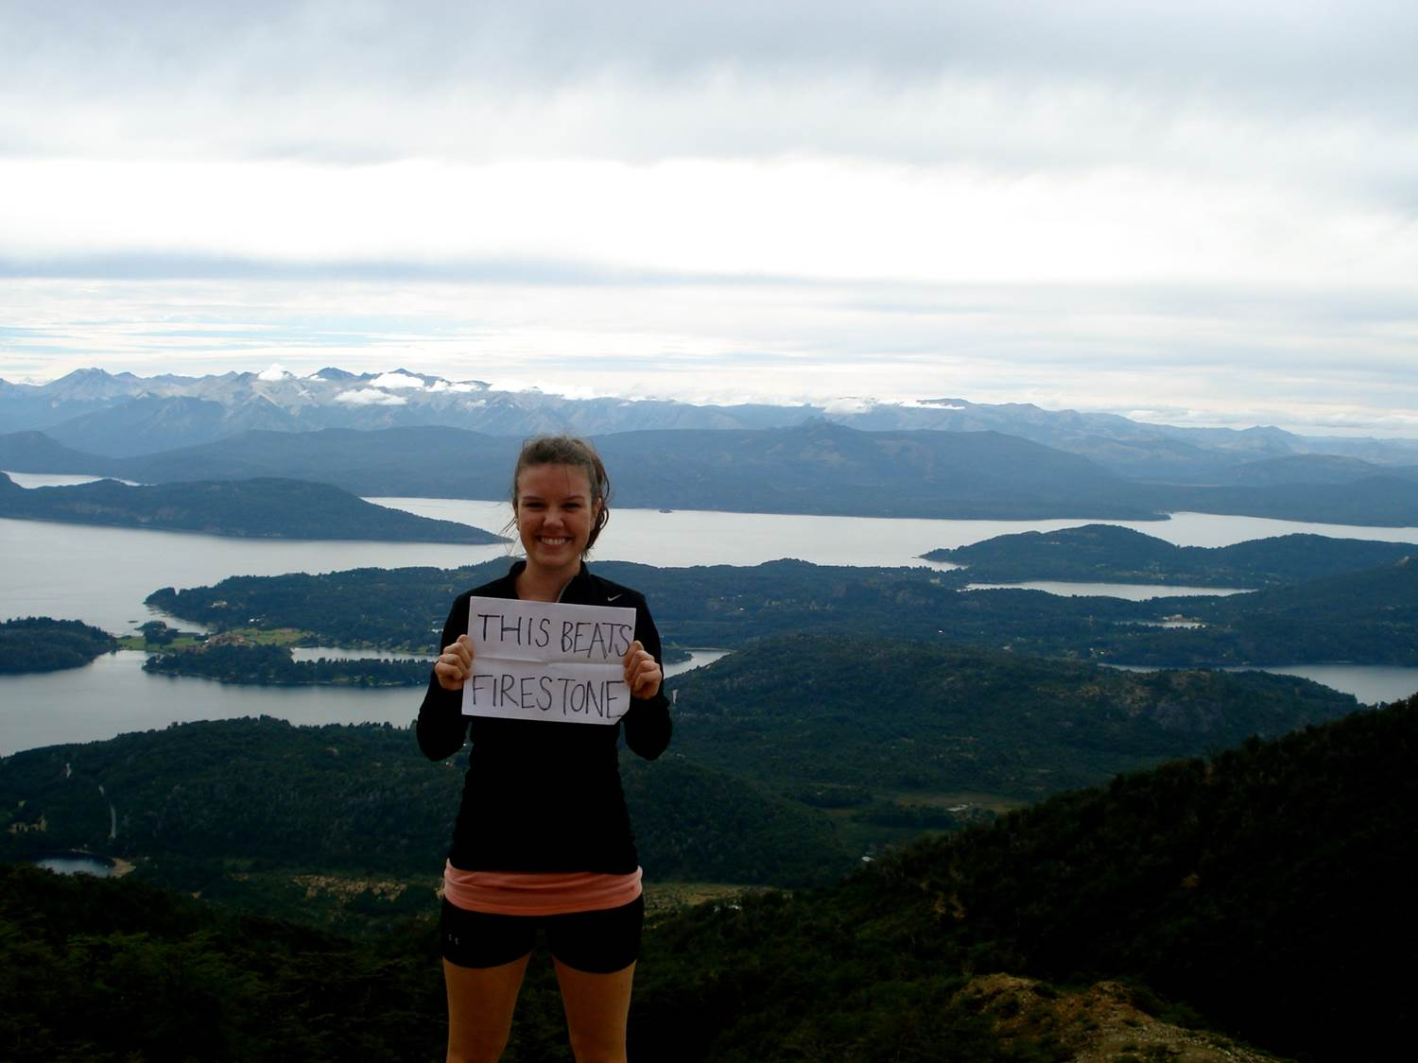
Study Abroad Opportunities for SPIA Juniors
Notes:
GG

Slide 17
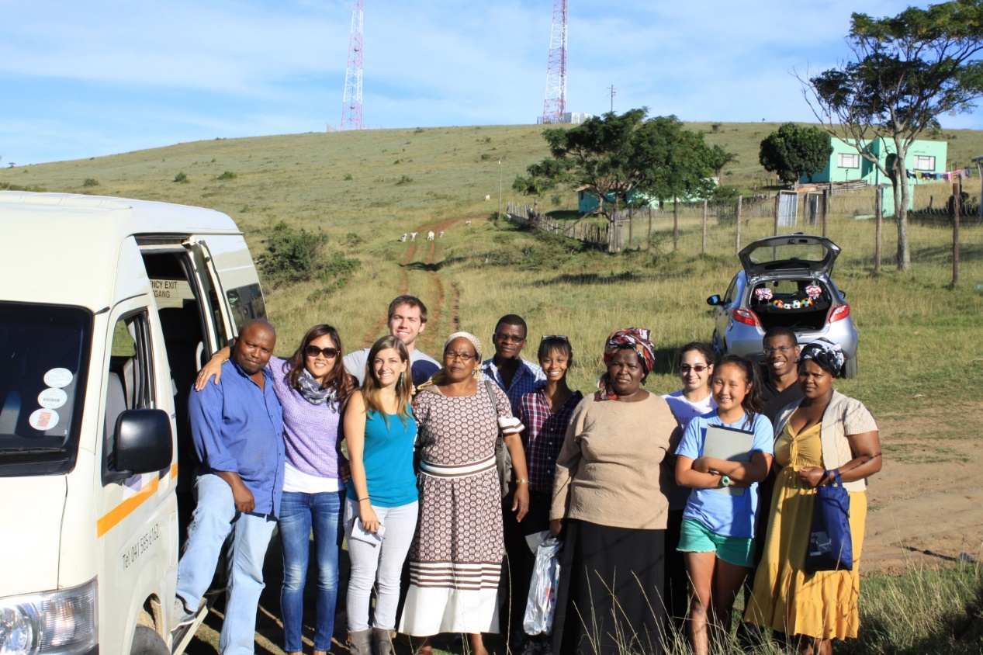
Why spend a semester abroad?
WHY STUDY ABROAD?
There are many benefits to integrating semester study abroad into your SPIA academic path at Princeton:
Meet your “international affairs” vocation
Supplement your Princeton academic program
Challenge yourself by experiencing a different educational system
Hone your language skills
Make yourself more competitive on the global job market
Discover new academic or extracurricular interests
Become more independent, flexible, and confident, and become better able to navigate ambiguity and difference
See the world
… and more!
Notes:
JZ

Slide 18
The SPIA Task Force model (Spring only)
WHY STUDY ABROAD?
A unique semester format supported by SPIA
Same goals as Task Forces at Princeton, but with the perk of an international setting
Task Force seminar taught by a local faculty with expertise on a policy topic that is of particular interest for the country the program is running in
The “best of both worlds,” as students also take courses at the local university – a great balance of being in a Princeton cohort and yet being independent
For Spring 2027, the Task Force seminar abroad will be offered in the Spring semester only, and in one location only: UCT South Africa—more on this later!
SPIA majors are strongly encouraged to participate in the Task Force program (min. 4 students per program to run it as a full seminar, but hopefully many more!) in Spring of junior year, although other options are available, e.g,:
Summer study abroad (deadlines vary)
Fall semester study abroad on any regular programs of your choice
Notes:
JZ

Slide 19
Fall vs. Spring options
Other options – Summer and Fall
Summer 2026:
Numerous faculty-led programs (PIIRS global seminars, language-intensive, departmental options): https://oip.princeton.edu/our-programs/study-abroad/explore-programs/princeton-faculty-led-summer-study-abroad-programs (a few are still accepting students!)
Of special interest: Policy Task Force in Geneva, Switzerland
Non-Princeton programs (transfer credit)—requires pre-approval, hurry up! (search in GPS and email ggisolo@princeton.edu with questions)
International internships-various programs/deadlines (no credit)
Summer funding available through SAFE/Dean’s Fund to qualifying students
Fall 2026:
THE PRINCETON FALL 2026 DEADLINE IS FRIDAY APRIL 24, 2026
SPIA juniors and seniors may participate in any available study abroad program, subject to these conditions:
Pre-approval from SPIA
Meet a Study Abroad adviser to learn about language requirements (if any), app process/deadlines, etc.
Meet the host program’s deadlines/requirements, and be accepted by them (some programs are “rolling admissions,” so important to know when they open in order to enhance your chances)
Complete a study abroad app (including course approval form) in GPS
Always subject to GS&S’s approval of international travel to specific countries
Notes:
TO BE UPDATED

Slide 20
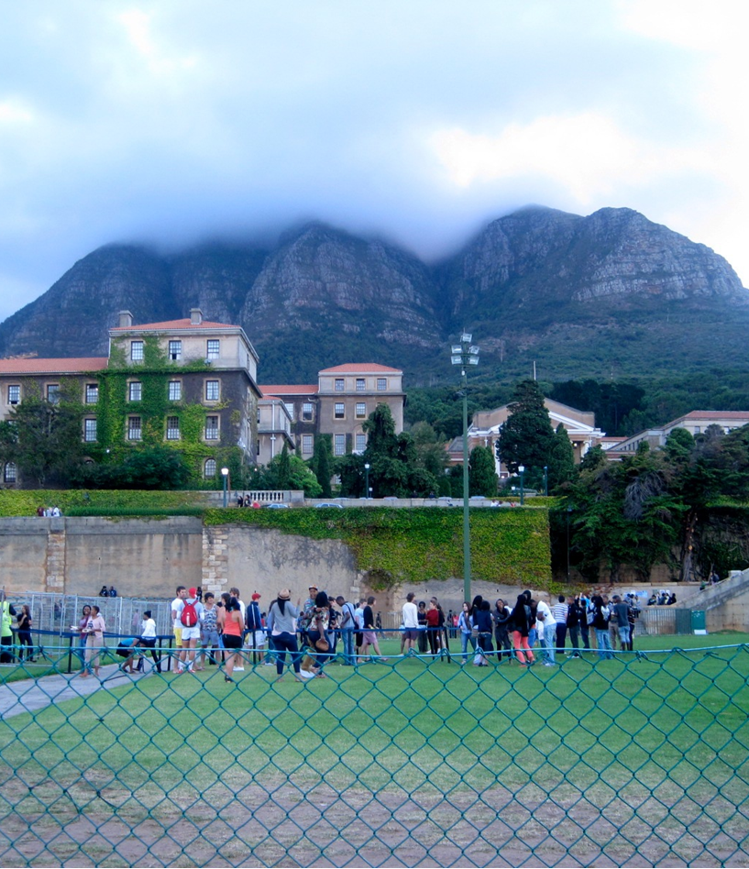
Spring 2027 Task Force @ The University of Cape Town, South Africa
Cape Town offers immense natural beauty
One of South Africa’s most distinguished universities
Princeton amongst the first universities to sign an agreement with UCT closely after the end of Apartheid
Task force seminar instructor (Spring ‘26): Prof. Seekings, Dept. of Sociology, Director of the Center for Social Science Research and Interim Director of the Institute for Democracy, Citizenship and Public Policy in Africa; specializes in poverty reduction, social protection, and welfare-state building.
Task force focus is on social protection programs
Notes:
JZ

Slide 21
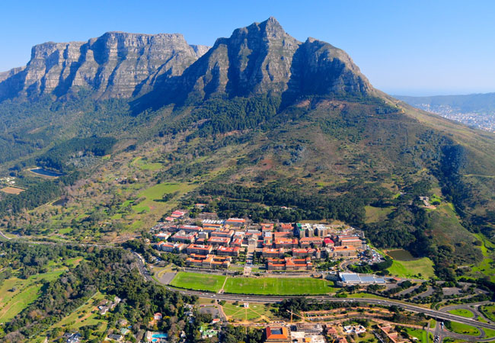
University of Cape Town, South Africa
Academics: take 3-4 courses or a total of 80-90 NQF credits at the University of Cape Town, a large, public university, plus the Task Force Seminar
Most students live in off-campus accommodations (student residence with all amenities, shared with other U.S. students from Princeton or other US universities) – see next slide
Lots of support provided by Ida Cooper Associates (coordination of housing, airport pick-up, orientation, excursions, safety/security support, rec. activities, community service opportunities, etc.)
Week-long trip to neighboring Botswana (with task Force seminar faculty)
Application deadline: TBD in early to mid October 2026 (but talk with a SA adviser before then!)
Important to start visa process early, as it is lengthy!
Semester dates (TBC): early February to mid-June 2027
Notes:
JZ
Mention the important role of Ida Cooper Associates in placing students in housing, providing assistance and cultural activities/volunteer placements, transportation from airport/to medical facilities, etc. etc.
If a student would rather prefer an on-campus accommodation, that is possible as well (but not very popular with our students)
South African visa process requires a lot of documents, so it’s important to start working on it early.

Slide 22
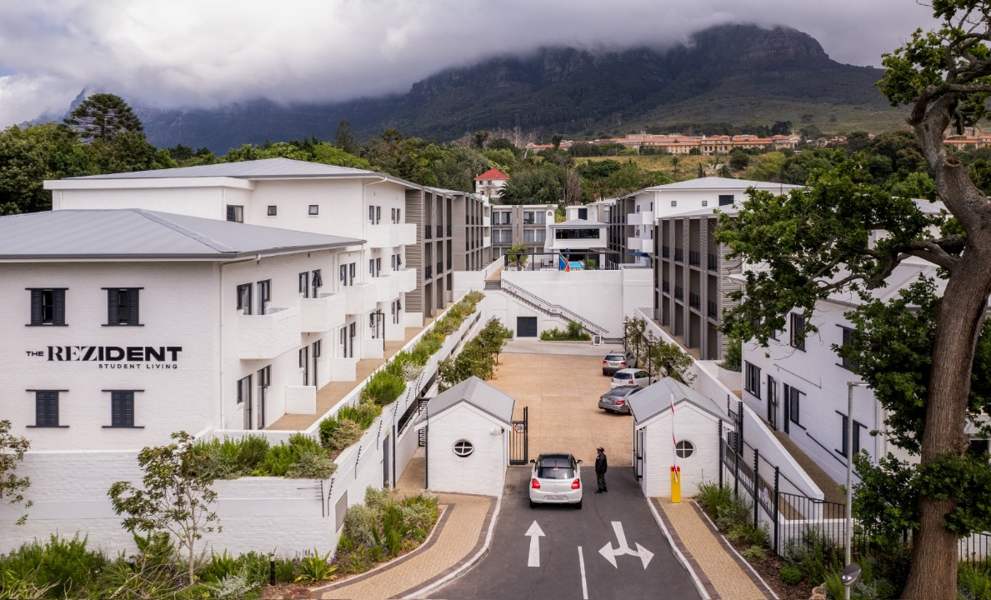



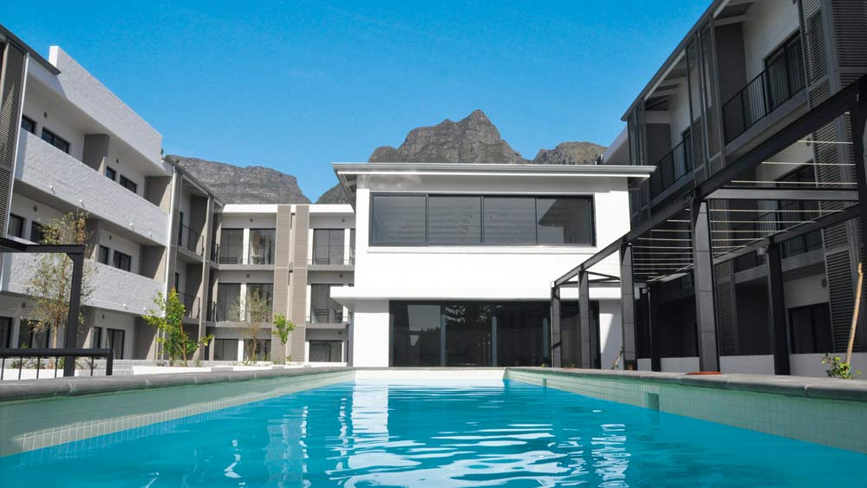
Student Housing
Notes:
JZ

Slide 23

Student Testimonials
“Studying abroad in Cape Town was one of the best decisions I've made at Princeton. Being away from the orange bubble presented a liberating challenge to learn more, see more, and do more in order to make the most of my time there. If you're considering studying abroad here or in general, my first piece of advice is to go for it.”
“My experiences outside the classroom benefited me both personally and academically. I learned to push myself out of my comfort zone when meeting new people and gain confidence, and academically, I saw firsthand the value of interview-based research.”
“Cape Town is the most incredible place I've ever been in my life. It has astonishing natural beauty and also offers all the conveniences and fun of a big city. The people are amazingly friendly and laid back and you really are able to go to some genuinely jaw-dropping places and do incredible activities. Plus, the Ida Cooper program is a massive support who will help you through everything.”
Notes:
JZ

Slide 24
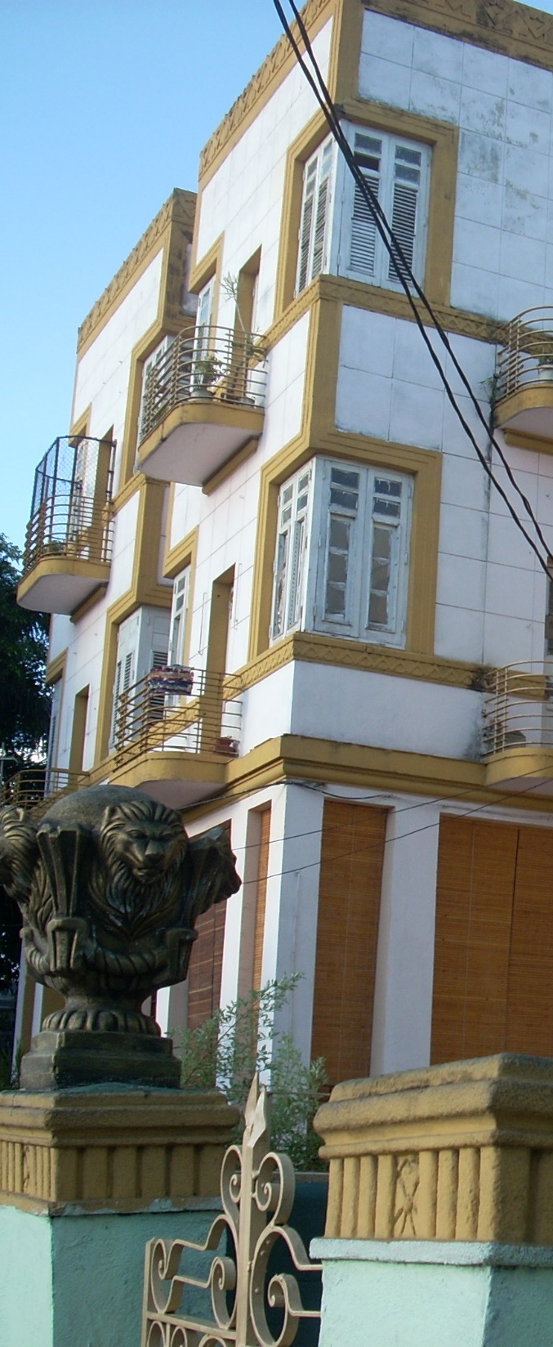
Semester study abroad
Eligibility
Junior SPIA status
At least B average for previous academic year (but some programs may require higher)
Good disciplinary and academic standing
Academics Abroad
Enroll in a full course load (varies by program)
Courses may fulfill departmental, certificate, distribution requirements or elective credits (all need to be pre-approved)
Transfer credit for courses taken abroad, provided you earn a D or better
Task Force will be given Princeton letter grade and Princeton credit
Task Force will be completed in addition to full- time coursework
All financial aid travels with you
Adjusted up or down depending on actual cost of attendance
Family contribution (if any) remains the same
Notes:
GG

Slide 25
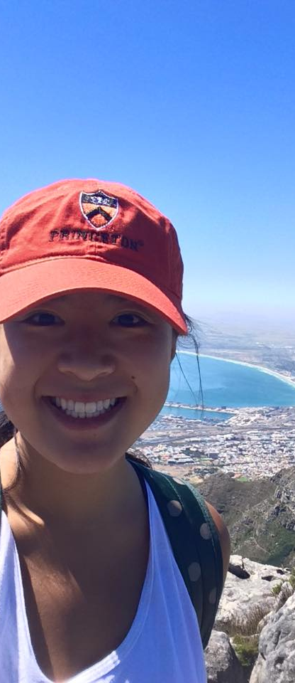
To recap…
Meet with a SA adviser (program-based) if you have any questions or concerns
Schedule in Bookings
Jordan Zilla: UCT
Complete an online application in GPS at gps.princeton.edu by these deadlines:
UCT: early October (DATE TBD), 2026
Complete the application on the host website in addition to the GPS application:
Application requirements vary by program, but may include:
Official transcript(s)
Personal statement
CV/resume
Initial course selection
Academic reference(s)
Application form and any special supplementary documents
Start working on your travel and visa documents:
Make sure you have a valid passport (expiring 6+ months after program’s end) – it may take a few months to obtain or renew one
Discuss estimated visa timelines with your SA adviser
Notes:
GG

Slide 26

Apply & Go!
Meet with an adviser
(Schedule in Booking):
Amanda El-Kadi: a.elkadi@
Gisella Gisolo: ggisolo@
Jordan Zilla: jzilla@ (UCT)
Olga Liamkina: olga.liamkina@
Office of International Programs
Louis A. Simpson International Bldg
Level A
sap@princeton.edu
www.princeton.edu/oip/sap
gps.princeton.edu
Notes:
GG

