Slide 1



Undergraduate
Policy Major
Princeton School of Public and International Affairs
with Zacharia Ahmed

Slide 2
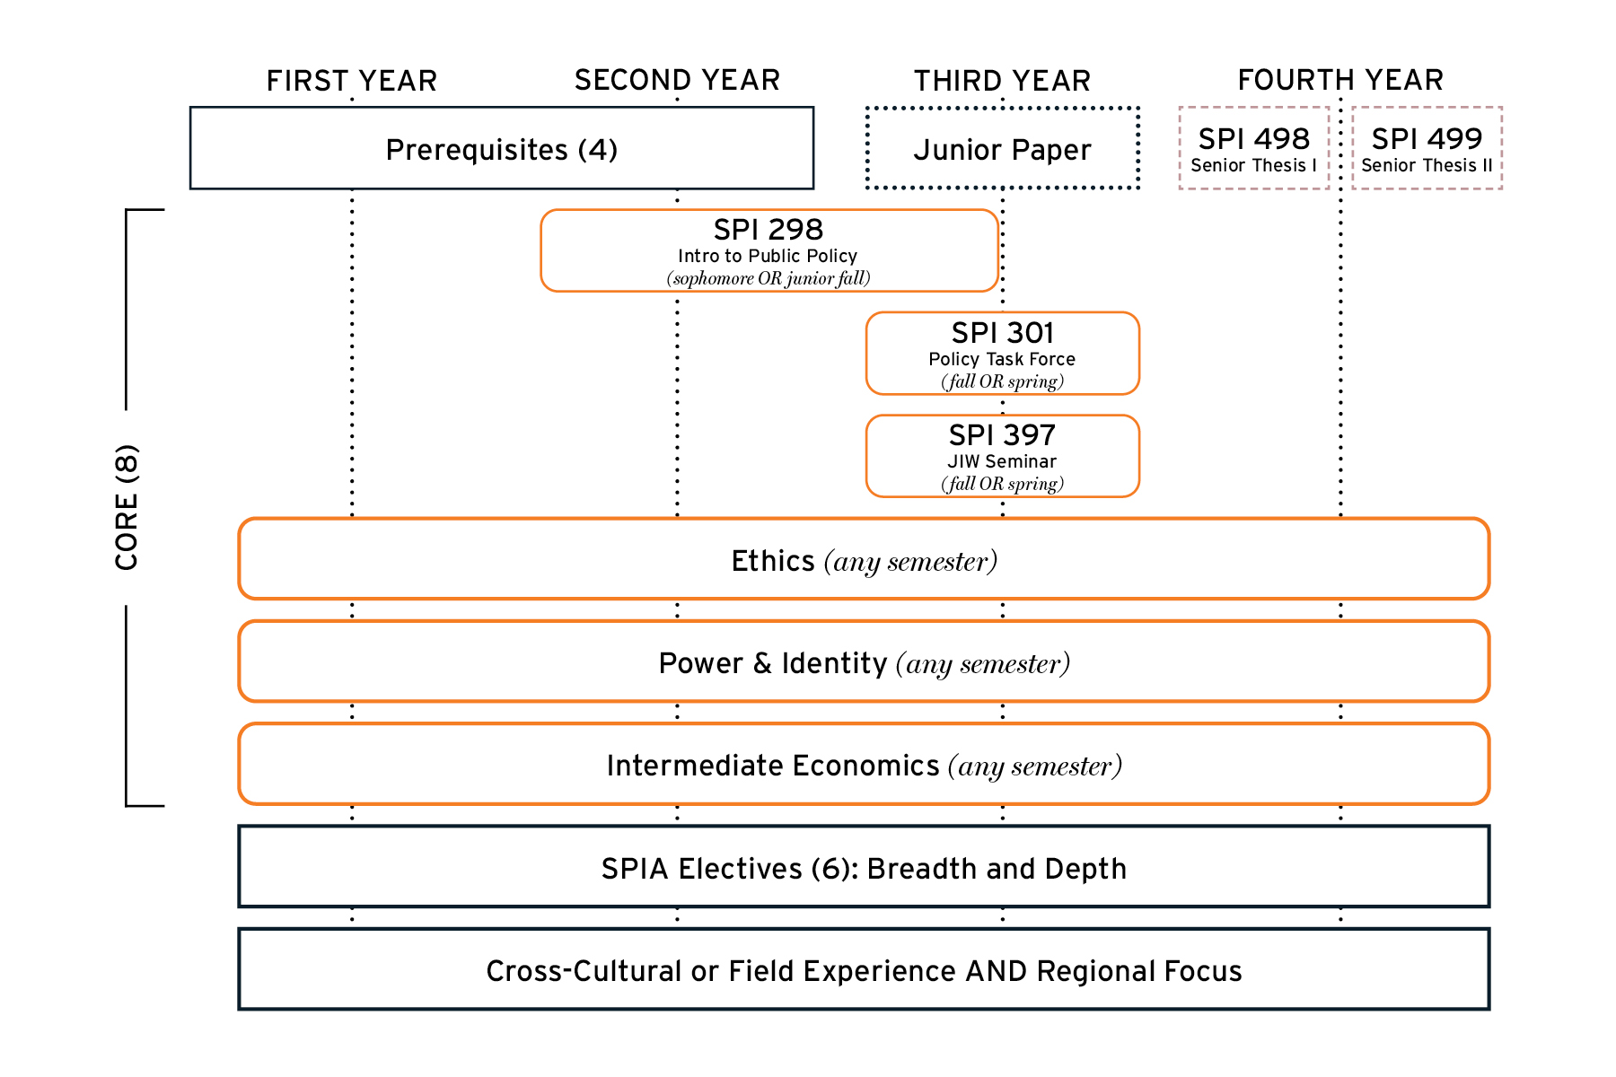
FOUR YEAR RHYTHM

Slide 3
Core Courses (8)
SPI 298
Intro to Public Policy
(FALL ONLY)
SPI 397
JIW Seminar
(SPRING ONLY)
SPI 301
Policy Task Force
(FALL or SPRING)
Intermediate Economics
Power & Identity
(CD)
Ethics
(EM)
School of Public and International Affairs
Undergraduate Major
Course Requirements
Pre-requisites (4)
Statistics
(fulfills QCR distribution requirement)
Microecon
History/
Politics
(HA or SA)
Sociology / Psychology
(SA or EC)
ECO 100
Junior Independent Work
SPI 397
SPI 200
ECO 202
ORF 245
POL 345/SPI 211
SML 201
Senior Independent Work
SPI 498 & SPI 499
Electives (6)
Disciplinary Breadth
AND
Intellectual Depth
See website for
detailed list
SPI 304
ECO 300
ECO 301
ECO 310
ECO 311
See website for
detailed list
See website for
detailed list
Regional Focus
(across all courses taken at Princeton)
See website for
detailed list
Cultural/Field-Work

Slide 4
ELECTIVES
(6 courses)
Intellectual Depth (3)
AND
Disciplinary Breadth (3)
Please note: all electives must be approved and listed on the master course list to count.
Additionally, all courses are recorded based on the home department title, no cross-listed departments will be taken into account

Slide 5
ELECTIVES
(6 courses)
Intellectual Depth (3)
Thematic Depth:
Three courses bound by a theme, drawn from SPIA-affiliated departments or SPIA-approved courses. Thematic areas include:
  Community and Individual Health, Education
  Economic Development
  Environment & Energy
  Globalization & International Relations
  Governance, Law & Citizenship
  Inequality & Human Rights
  National and International Security & Conflict
Disciplinary Depth:
Three courses in one SPIA-affiliated department – e.g., CEE, COS, ECO, EEB, GEO, HIS, MAE, POL, PSY, SOC, SPI
OR
Notes:
Google form needed for Thematic depth – default Disciplinary Depth
Make sure that the course(s) you are looking at are approved on our electives list.

Slide 6
ELECTIVES
(6 courses)
Disciplinary Breadth (3)
Three courses each from a unique SPIA-affiliated department listed here: CEE, COS, EEB, ENV, GEO, GHP, HIS, MAE, POL, PSY, SOC, SPI
The SPIA-affiliated department used to fulfill the Breadth should not overlap with you Depth electives
Among the six (6) electives, no more than three (3) courses may come from a single department.
ECO excluded as it’s already a required prerequisite and Core course.

Slide 7
Things to keep in mind…..
Regional Focus
Across all course work
at least two courses must have a substantive
focus on one particular continent.
Notes
No course may count as two (2) prerequisites, or core, or elective courses.
A single course may double or triple count as a prerequisite, core, and/or elective.
Across entire concentration, a maximum of five (5) courses may come from a single department, not including SPI courses.
Notes:
Curriculum linked to electives title

Slide 8
Master Course List
Notes:
This course is credit bearing and not tied to the JIW

Slide 9
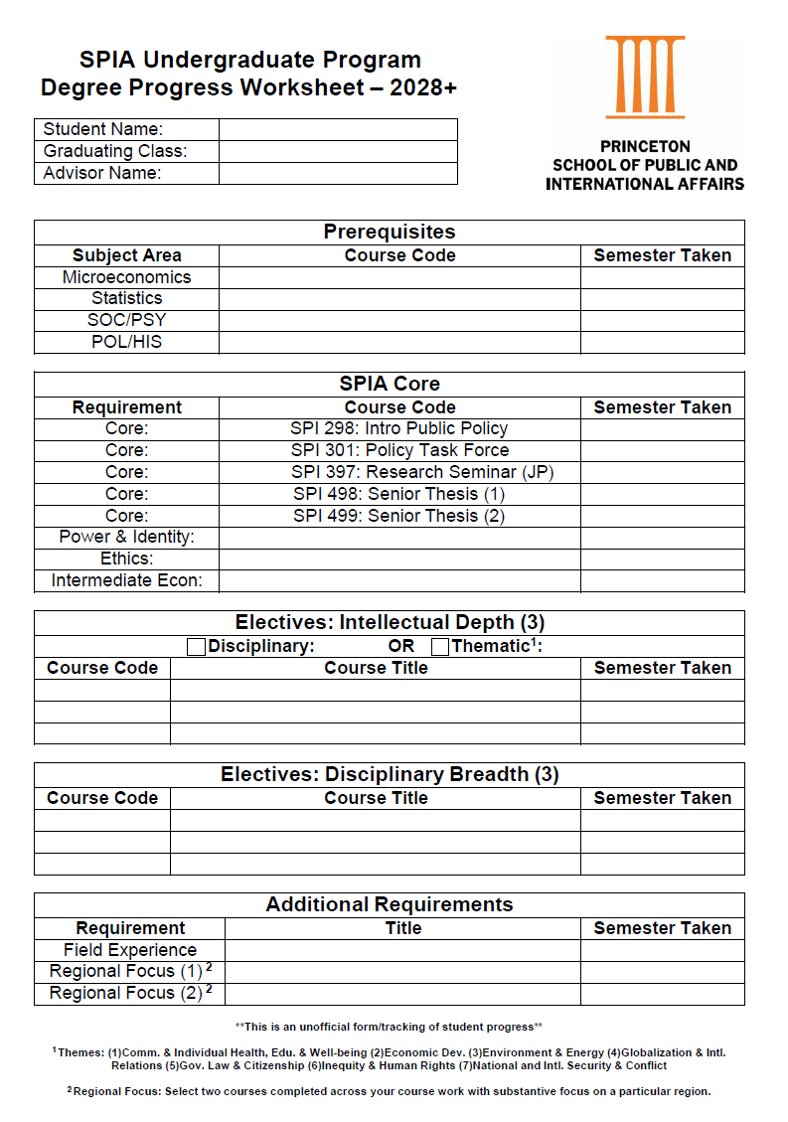
Tracking Progress
Fillable PDF found on the SPIA website
Use in collaboration with your adviser to ensure you are on track with all SPIA course work
Strongly encourage all students to start using this now!
Notes:
This course is credit bearing and not tied to the JIW

Slide 10
SPIA CULTURAL /
FIELD-WORK REQUIREMENT
Examples from past years…
Study Abroad
Internships - Gov't
Internship - Non-Profit
Internship - PICS
Internship - Int'l Agency
Service in Underdeveloped Communities
Princeton Bridge Year
Global Seminars
Thesis Research
ROTC
Note: It is strongly recommended to check with our office to ensure that your experience will fulfill this requirement.

Slide 11
Considerations for Study Abroad
If you plan to study abroad in the spring of your Junior year at the University of Cape Town, you must complete SPI 397 in the Fall of your Junior Year.
Options to study abroad in SPIA:
  Sophomore Summer – International PTF
  Junior Fall – location of your choice
  Junior Spring – University of Cape Town (UCT)
  Senior Fall – location of your choice, but you must have a confirmed thesis adviser by the end of junior spring
Notes:
Sophomore Summer abroad?
This course is credit bearing and not tied to the JR Independent Work
Reminder: OIP will be presenting after me

Slide 12

Princeton School of Public and International Affairs
UNDERGRADUATE PROGRAM OFFICE
Zacharia Ahmed
Undergraduate Academic Adviser
Jennifer Skillman
Academic Coordinator
Kelly Pereira
Administrative Coordinator
Liz Choe
Director, Undergraduate Program & Career Services

Slide 13
Princeton School of Public and International Affairs
Questions?
Email: spiaugrd@Princeton.edu
Website: spia.princeton.edu

